Slide 1
AI & Prompt Engineering
Mohammed Armaan Uddin – RC19229
Notes:
Regional U.S.

Slide 2
Why Prompt engineering & Copilot?
Studies show that prompt design can significantly impact the quality and relevance of AI-generated outputs - Language Models are Few-Shot Learners” (Brown et al., 2020)
Research indicates that Copilot can help developers code up to 55% faster for repetitive tasks and improve productivity.
Between 60–75% of users reported they feel more fulfilled with their job, feel less frustrated when coding, and can focus on more satisfying work when using GitHub Copilot.
Developers reported that GitHub Copilot helped them stay in the flow (73%) and preserve mental effort during repetitive tasks (87%) - Research: quantifying GitHub Copilot’s impact on developer productivity and happiness - The GitHub Blog
Notes:
Chevron Bullets

Slide 3
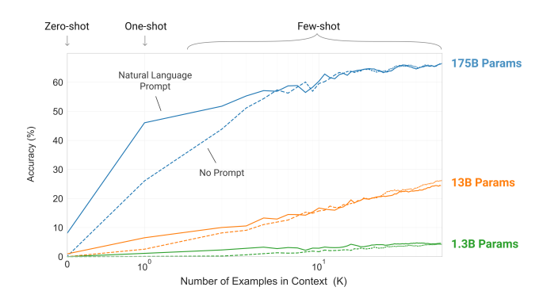
Zero-shot vs one-shot vs few-shot prompting

